Slide 1

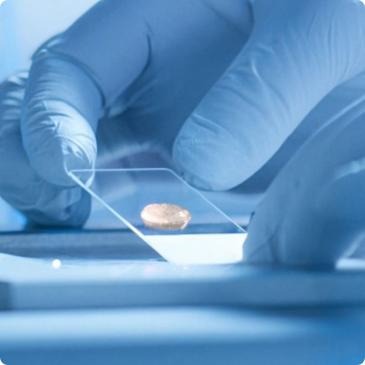

L'ORÉAL SUSTAINABILITY CHALLENGE 2026
RESEARCH & INNOVATION
95% GREEN CHEMISTRY
REAL-TIME TELEMETRY
EPIDERM-X
Hyper-Local Environmental Resilience Engine & Predictive Longevity Bio-System
Focus: Gen Z Exposome Aging
Tech: AI Diagnostics & Upcycled Bio-Shields
L'ORÉAL R&I CONCEPT
Global Challenge Submission
EPIDERM-X Pitch Deck

Slide 2
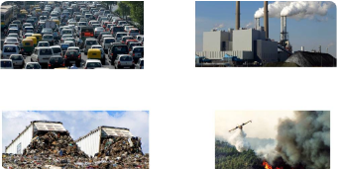
01 / CONTEXT & PROBLEM STATEMENT
MARKET URGENCY
The Gen Z "Exposome Aging" Shift
GEN Z TARGET AUDIENCE
Gen Z is aging under accelerated micro-climate & pollution stress.
Particulate Penetration ($\text{PM}_{2.5}$): Micro-particulates breach skin lipid barriers, accelerating collagen breakdown and scalp inflammation before age 25.
Static daily skincare routines fail to adapt to volatile urban environments.
Micro-Climate Volatility: Unpredictable humidity, high UV spikes, and urban heat islands trigger persistent barrier damage and oxidative stress.
Consumer Disconnect: 73% of Gen Z consumers report traditional static cosmetics do not adapt to their active, multi-city lifestyle.
PM2.5 & UV STRESS
L'Oréal Sustainability Challenge 2026
EPIDERM-X Pitch Deck

Slide 3
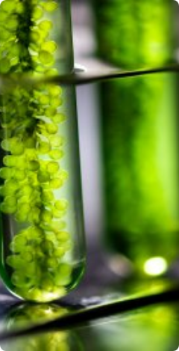



02 / CORE INNOVATION
SOLUTION ARCHITECTURE
Real-Time Environmental Resilience
01. DATA & AI
02. HARDWARE ENGINE
03. GREEN BIOTECH
Hyper-Local Diagnostic API
Dynamic Bi-Phase Dispenser
Upcycled Bio-Ferment Shield
Ingests block-level weather, humidity, and air quality telemetry to forecast daily skin stress 24 hours in advance.
Smart micro-dosing bottle mechanism that automatically adjusts formula ratios based on ambient exposure forecasts.
Zero-land extremophile algal ferment forming a breathable, physical anti-pollution defense layer on skin and hair.
PREDICTIVE STRESS SCORE
CUSTOM MICRO-DOSING
100% UPCYCLED ACTIVES
L'ORÉAL R&I GREEN BIO-LAB
L'Oréal Sustainability Challenge 2026
EPIDERM-X Pitch Deck

Slide 4
03 / IMPLEMENTATION FRAMEWORK
STRATEGIC PILLARS
The EPIDERM-X Ecosystem
ANALYTICS & ML
GREEN SCIENCES
Pillar I — AI Exposome Telemetry
Pillar II — Green Biotech Actives
Predictive machine learning models trained on hyper-local satellite and IoT ambient sensors to map oxidative risk.
100% bio-sourced active shield harvested via zero-land, carbon-neutral micro-algae fermentation.
DIGITAL UX
SUSTAINABILITY
Pillar III — Adaptive Digital App
Pillar IV — Circular Closed-Loop
Gen Z mobile companion app providing daily exposure scores, adaptive formula guides, and sustainability streaks.
100% PCR aluminum pod cartridges and waterless formula concentrates aligned with L'Oréal 2030 targets.
L'Oréal Sustainability Challenge 2026
EPIDERM-X Pitch Deck

Slide 5
04 / QUANTIFIABLE OUTCOMES
IMPACT SCORECARD
Projected Value & Sustainability
CLINICAL LONGEVITY
ENVIRONMENTAL IMPACT
BUSINESS VALUE
-68%
-82%
€180M
Oxidative Stress Reduction
Packaging Carbon Footprint
24-Month Market Potential
Clinical defense against urban $\text{PM}_{2.5}$ particles and reactive oxygen species.
Achieved via waterless formula concentrates and lightweight aluminum refills.
Projected subscription model expansion across major polluted urban centers.
L'Oréal Sustainability Challenge 2026
EPIDERM-X Pitch Deck

Slide 6

RESEARCH & INNOVATION SUBMISSION
L'ORÉAL 2026
NEXT-GEN SCIENCE
L'ORÉAL FOR THE FUTURE ALIGNMENT
Pioneering Longevity for the Climate Era
EPIDERM-X combines predictive intelligence and green biotech to safeguard Gen Z skin & hair health today and into the future.
Thank You — Ready for Questions & Judging Discussion
L'Oréal Sustainability Challenge 2026
EPIDERM-X Pitch Deck

Slide 7



Image Sources
https://www.loreal.com/-/media/project/loreal/brand-sites/corp/master/lcorp/5-science-and-technology/skin-tech/skin-tech-hero.jpg?rev=b0c0e1edd3874081bfde836d7e358506
Source: www.loreal.com
https://qeios-uploads.s3.eu-west-1.amazonaws.com/editor/q5WIDi2P4ZkAD44ckCyomQLF5JbYUwgfgYtbdTqM.jpg
Source: www.qeios.com
https://www.loreal.com/-/media/project/loreal/brand-sites/corp/master/lcorp/press-releases/historical-press-releases/2022/291122/photogreen-sciences-1.jpg?rev=dd9f3adf247849bd85c3668e3afe9ee9
Source: www.loreal.com

